Slide 1
Embedded System
Define Embedded System?
What are the main components of an Embedded system?
What are the characteristics of an Embedded system?
What are the Advantages of an Embedded system?
Draw the basic structure of an embedded system?

Slide 2
Definition of an Embedded System
Embedded means something that is attached to another thing.
An embedded system can be thought of as a computer hardware system having software embedded in it.
An embedded system can be an independent system or it can be a part of large system.
An embedded system is a microcontroller or microprocessor based system which is designed to perform a specific task.

Slide 3
Main components of an Embedded system
Hardware
Application software
Real Time Operating System: RTOS defines the way the system works. It sets the rules during the execution of application programs.
Small scale embedded system may not have RTOS.

Slide 4
Characteristics of an Embedded system
Single-functioned: An embedded system usually performs a specialized operation and does the same repeatedly.
Tightly-Constrained: All computing systems have constraints on design metrics but those on an embedded system can be especially tight.
Reactive and Real Time: Many embedded systems must continually react to changes in the system’s environment and compute certain results in real time without any delay.
Memory: It must have a memory, as its usually embeds in ROM. It does not need any secondary memories in the computer.
Connected: it must have peripherals to connect input and output devices.
HW-SW systems: Software is used for features and flexibility. Hardware is used for performance and security.

Slide 5
Advantages & Disadvantages of an embedded system
Advantages:
1. Easily customizable.
2. Low power consumption
3. Low cost
4. Enhanced performance.
Disadvantages:
1. high development effort.
2. Lager time to market.

Slide 6
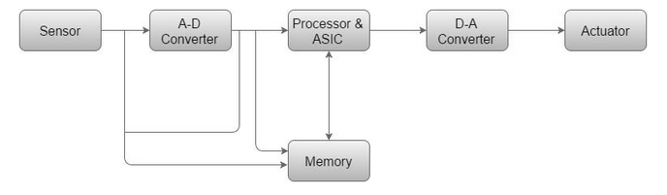
Structure of an Embedded System

Slide 7
Embedded system-Processor
What is a processor?
Main units of a Processor?
Types of Processor
1. GPP(General purpose Processor)
2. ASSP (Application Specific System Processor)
3. ASIP (Application Specific Instruction Processor)

Slide 8
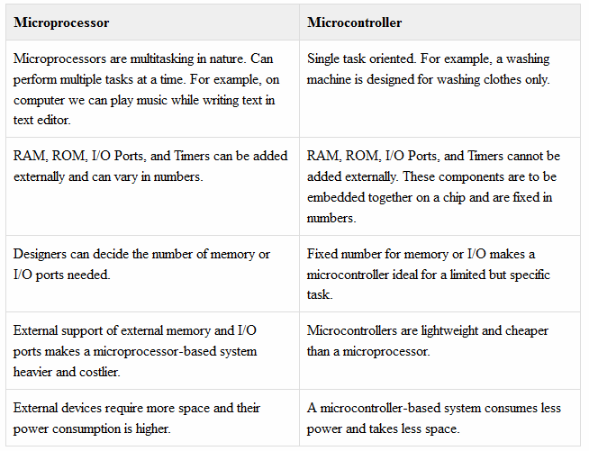
Difference between Microprocessor & Microcontroller

Slide 9
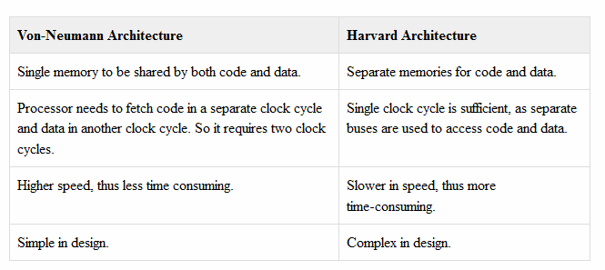
What is the difference between Von-Neumann Architecture and Harvard Architecture

Slide 10
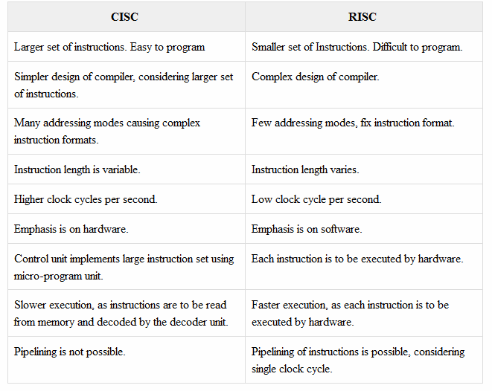
CISC Vs RISC

Slide 11
What is a Compiler?
A compiler is a computer program or a set of programs that transforms the source code written in a programming language the source language into another computer language normally binary format. The most common reason for conversion is to create an executable program. The name "compiler" is primarily used for programs that translate the source code from a high level programming language to a low-level language e.g., assembly language or machine code.

Slide 12
What is Decompiler?
A program that can translate a program from a low-level language to a high-level language is called a decompiler

Slide 13
What is language converter?
A program that translates programs written in different high-level languages is normally called a language translator, source to source translator, or language converter.
A compiler is likely to perform the following operations −
Preprocessing
Parsing
Semantic Analysis Syntax−directed translation
Code generation
Code optimization

Slide 14
What is an Assembler?
An assembler is a program that takes basic computer instructions called as assembly language and converts them into a pattern of bits that the computer's processor can use to perform its basic operations. An assembler creates object code by translating assembly instruction mnemonics into opcodes, resolving symbolic names to memory locations. Assembly language uses a mnemonic to represent each low-level machine operation opcode.

Slide 15
What is the importance of Debugging tools?
Debugging is a methodical process to find and reduce the number of bugs in a computer program or a piece of electronic hardware, so that it works as expected. Debugging is difficult when subsystems are tightly coupled, because a small change in one subsystem can create bugs in another. The debugging tools used in embedded systems differ greatly in terms of their development time and debugging features.

Slide 16
What are the Debugging tools you know in Embedded systems?
Simulators
Microcontroller Starter Kits
Emulators

Slide 17
What is Simulator?
Code is tested for the MCU / system by simulating it on the host computer used for code development. Simulators try to model the behavior of the complete microcontroller in software.

Slide 18
What is the advantage of Microcontroller Starter Kits over Simulators?
Advantage of these kits over simulators is that they work in real-time and thus allow for easy input/output functionality verification. Starter kits, however, are completely sufficient and the cheapest option to develop simple microcontroller projects.

Slide 19
What is Emulation?
Emulation refers to the ability of a computer program in an electronic device to emulate imitate another program or device.
Emulation focuses on recreating an original computer environment.
Emulators have the ability to maintain a closer connection to the authenticity of the digital object.
An emulator helps the user to work on any kind of application or operating system on a platform in a similar way as the software runs as in its original environment.

Slide 20
What is the purpose of using Peripheral devices in Embedded systems?
Embedded systems communicate with the outside world via their peripherals

Slide 21
What is the criteria for choosing a Microcontroller?
While choosing a microcontroller, make sure it meets the task at hand and that it is cost effective.
We must see whether an 8-bit, 16-bit or 32-bit microcontroller can best handle the computing needs of a task.
Speed − What is the highest speed the microcontroller can support?
Packaging − Is it 40-pin DIP Dual−inline−package or QFP Quad flat package? This is important in terms of space, assembling, and prototyping the end-product.
Power Consumption − This is an important criteria for battery-powered products.
Amount of RAM and ROM on the chip.
Count of I/O pins and Timers on the chip.
Cost per Unit − This is important in terms of final cost of the product in which the microcontroller is to be used.
Further, make sure you have tools such as compilers, debuggers, and assemblers, available with the microcontroller.

Slide 22
Little-Endian Vs Big-Endian?
Although numbers are always displayed in the same way, they are not stored in the same way in memory.
Big-Endian machines store the most significant byte of data in the lowest memory address.
Little-Endian machines, on the other hand, store the least significant byte of data in the lowest memory address.

Slide 23
For e.g. for storing the data 0x12345678 is…..
Big-Endian machines
ADD+0: 0x12
ADD+1: 0x34
ADD+2: 0x56
ADD+3: 0x78
Little-Endian machines
ADD+0: 0x78
ADD+1: 0x56
ADD+2: 0x34
ADD+3: 0x12

Slide 24
What are the features of an 8051 Microcontroller?
64K bytes on-chip program memory ROM
128 bytes on-chip data memory RAM
Four register banks
128 user defined software flags
8-bit bidirectional data bus
16-bit unidirectional address bus
32 general purpose registers each of 8-bit
16 bit Timers usually2,but may have more or less
Three internal and two external Interrupts
Four 8-bit ports,shortmodelhavetwo8−bitports
16-bit program counter and data pointer
8051 may also have a number of special features such as UARTs, ADC, Op-amp, etc.

Slide 25
8051 is of which Architecture type?
Harvard Architecture?
Von-Neumann Architecture?

Slide 26
What do you know about PIC Microcontroller?
PIC stands for?-Peripheral Interface controller
How PIC is better compared to 8051?
PIC microcontroller is fast and easy to implement program when we compare other microcontrollers like 8051. The ease of programming and easy to interfacing with other peripherals PIC became successful microcontroller.

Slide 27
How can you justify PIC is fast compared to 8051?
PIC mainly used modified Harvard architecture and also supports RISC (Reduced Instruction Set Computer) by the above specification RISC and Harvard we can easily that PIC is faster than the 8051 based controller which is made-up of Von-Newman architecture.

Slide 28
Advantages of PIC?
They are reliable and malfunctioning of PIC percentage is very less. And performance of the PIC is very fast because of using RISC architecture.
Power conception is also very less when compared to other micro controllers. When we see in the programmer point of view interfacing is very easy, also we can connect analog devices directly with out any extra circuitry and use them. Programming is also very easy when compared to other microcontrollers.

Slide 29
Disadvantages of PIC?
The length of the program will be big because of using RISC (35 instructions).
Program memory is not accessible and only one single accumulator is present.

Slide 30
Thank You!

